Slide 1
SF Food Inspection Use Case
By: Scott W. Davis

Slide 2
Introduction
Food inspection involves not only sampling and testing of end products but also assessing food centers to ensure compliance with food safety management systems. This minimizes the occurrence of public health food safety problems. Food inspection dates back to ancient times as part of the history of public health. The Food and Drug Administration (FDA) publishes the Food Code that sets guidelines and procedures to assist in food control jurisdictions. The Food Code provides a scientifically and legally backed basis for regulating the retail and food service industries.

Slide 3
Objectives
The food inspectors can then have a “Critical first” inspection approach where the places that have been predicted to have critical violations are inspected first.
Some of the factors that tend to predict critical violation include previous critical violations, high temperatures, nearby sanitation complains, nearby burglaries etc
This report would be beneficial to public health specialists and every stakeholder working to alleviate public health concerns through preventive measures.
It is not to introduce food inspection since these professionals are already carrying out food inspections in the relevant jurisdictions but to make the process more efficient.

Slide 4
Data Description
After conducting an inspection of the facility, the Health Inspector calculates a score based on the violations observed.
Violations found during inspections carry point values, and a restaurant’s score corresponds to a letter grade. The point/grade cut-offs are the same as for mobile food vending letter grading, with fewer points corresponding to a better grade:
"A" grade: 0 to 13 points for sanitary violations
"B" grade: 14 to 27 points for sanitary violations
"C" grade: 28 or more points for sanitary violations

Slide 5
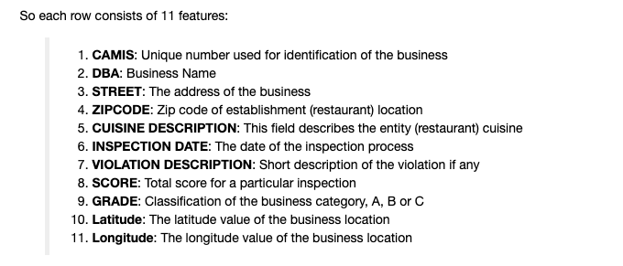
Data Description

Slide 6
Methodology
Collect Inspection Data
Explore and Understand the Data
Data preparation and preprocessing
Modeling
Evaluation and Testing

Slide 7


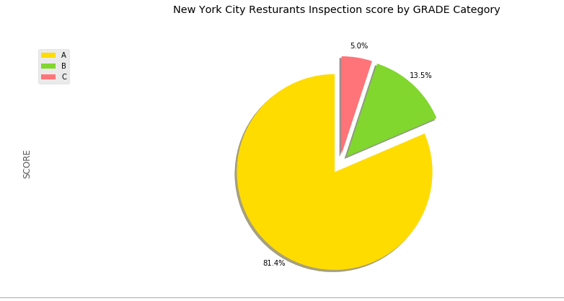
Results: Inspections In general

Slide 8
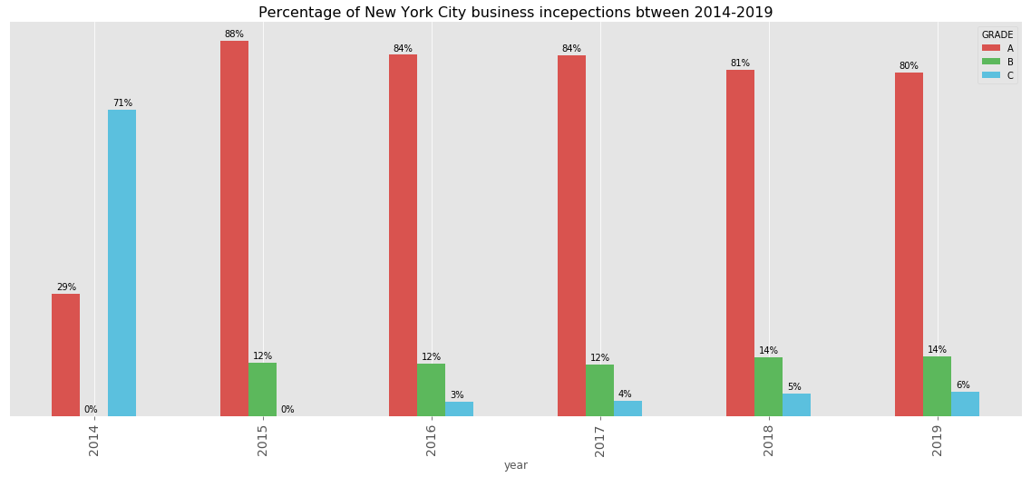
Results: Inspections by year

Slide 9
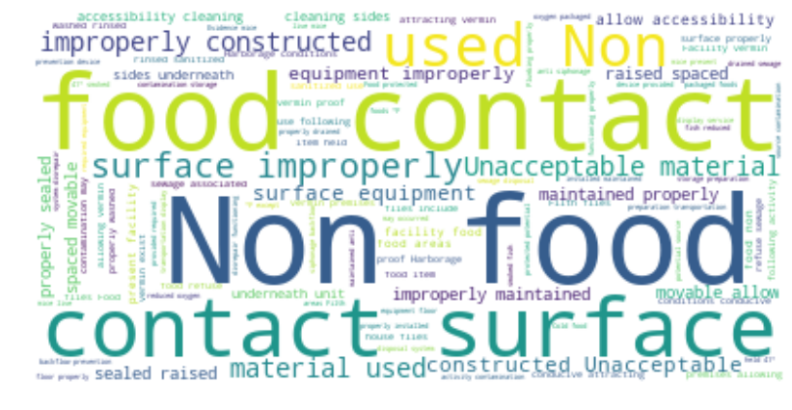
Violation description cloud words

Slide 10
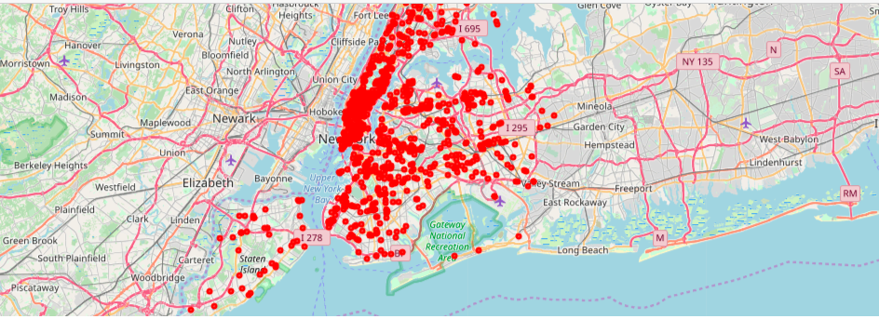
visualize the locations of the inspections
In order to reduce computational cost, let's just work with the first 100 inspections in this dataset.

Slide 11
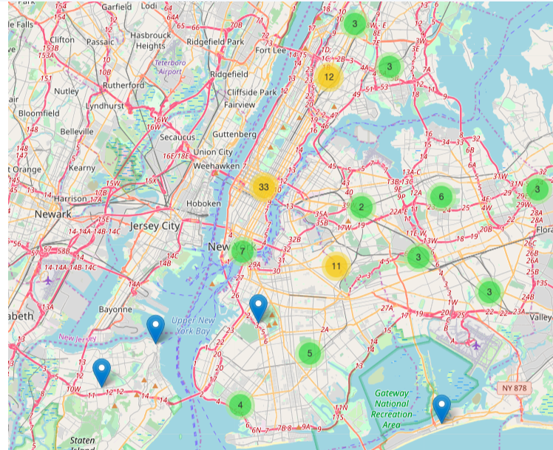
A clean and categorized copy of the map of New York

Slide 12
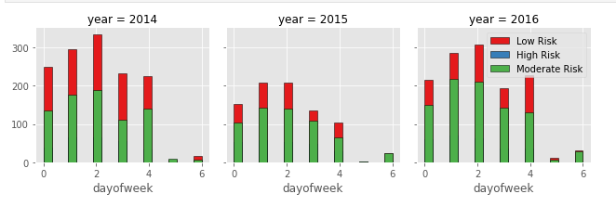
Inspection activities days of the week

Slide 13
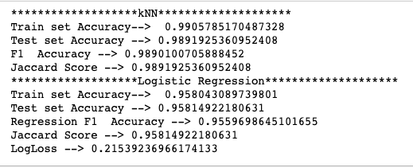
Machine learning Algorithm results

Slide 14
using Foursquare to analyze the neighborhood of the inspected businesses
In order to reduce computational cost, let's just work with the first 100 inspections in this dataset
We choose “The Evelyn Hotel NYC” it is A Grade inspection and it got 96 score

Slide 15
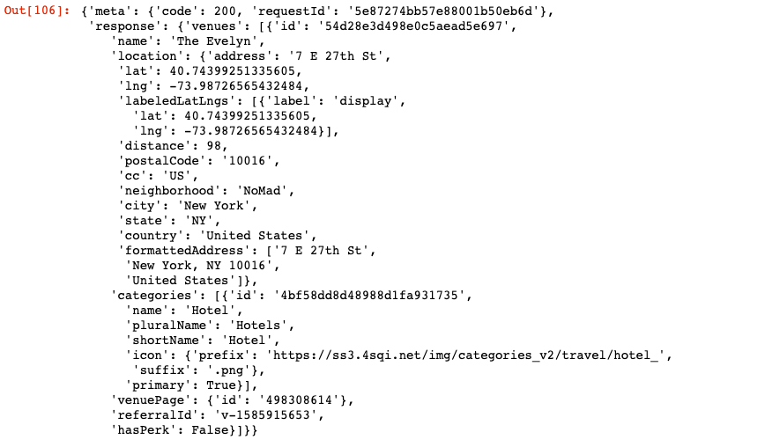
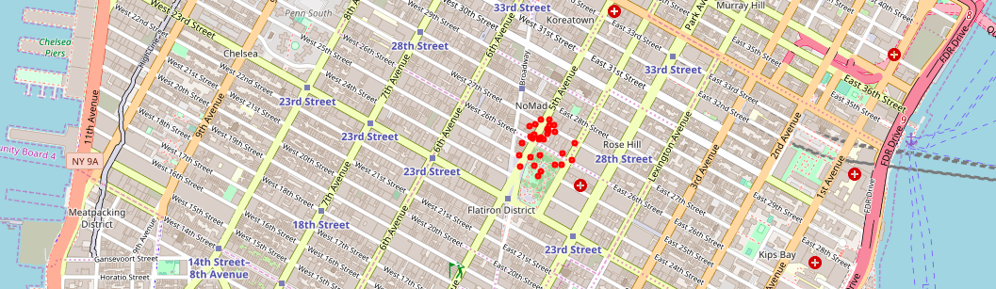
“the evelyn hotel nyc” Venues data and location

Slide 16
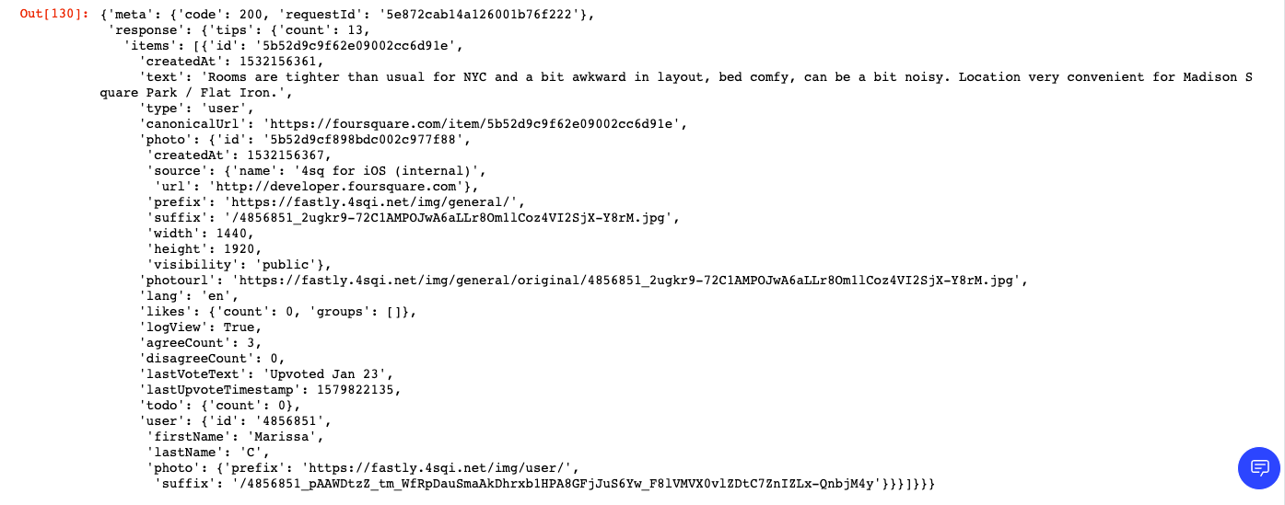
Foursquare API gives us we are able to only show one tip
Example of one tip

Slide 17
Foursquare User
We also examine the user who made that tip and we found that:
She is female
Here first name is Marissa and Last Name: C,
Marissa is less active in Foursquare as she has 15 tips.

Slide 18
Conclusion
To promote health, stakeholders in the healthcare industry need to continuously innovate to make the process more efficient. In food inspection, technology can be used to predict a likely critical violation through the use of data analytics instead of inspecting every joint blindly given the lack of enough manpower for this. The data used to predict critical violation include weather, crime and inspection data. Afterward, places data e.g. Foursquare is used to locate the food establishment for physical inspection

